Slide 1

Database Definition
» A database is a set of related data that has a regular structure and that is organized in such a way that a computer can easily find the desired information.
» A database is a collection of information that is organized so that it can easily be accessed, managed, and updated.
» A database is a collection logically related data.

Slide 2

DBMS Definition
» A DBMS (Database Management System) is a set of software programs or a tools which helps the user to perform all related operations i.e. to store, access, and process data or facts into useful information.
» A DBMS guarantees security, integrity, and privacy
by providing a centralized control of database.

Slide 3

DBMS Examples
» Free and Open Source
MySQL
PostgreSQL
˃
˃
SQLite
Firebird
» Proprietary and Closed Source
Microsoft SQL Server (MS SQL)
˃
˃
DB2
Oracle
Microsoft Access

Slide 4

Application Program Definition
» An application program (sometimes shortened to
application) accesses the database by sending queries or requests to the DBMS via a GUI (Graphical User Interface).

Slide 5

Database System Definition
» The database, the DBMS software, and the application program together are called a database system.
Computerized Library Systems
ATM (Automated Teller Machines)
Flight Reservation Systems
Computerized Human Resource Systems

Slide 6

Relationship Definition
» When creating a database, common sense dictates that we use separate tables for different types of entities to reduce and overcome redundancy.
» We need to establish relationships between these separated tables to provide useful information.
» A relationship exists between two database tables when one table has a foreign key that references the primary key of another table.

Slide 7

Types of Relationships
» One to One Relationships
Both tables can have only one record on either side of the relationship.
» One to Many / Many to One Relationships
The primary key table contains only one record that relates to none, one, or many records in the related table.
» Many to Many Relationships
Each record in both tables can relate to any number of records (or no records) in the other table.
» Self Referencing Relationships
This is used when a table needs to have a relationship with itself.

Slide 8

JOINS
» When selecting data from multiple tables with relationships, we will be using the JOIN query.
» INNER JOIN
» Natural JOIN
» Left (Outer) JOIN
» Right (Outer) JOIN
» Cross JOIN

Slide 9

JOIN in Live Examples
Students Subjects
code | first_name | last_name
20120 | Abdul Rahman | Sherzad
20121 | Cristina | Silva
20122 | Bob | Logan
20123 | Ana | Nava
20124 | Sekila | Manzikalla
id | subject_name
1 | Web Development
2 | Web Design
3 | Concept of Programming
4 | Fundamentals of Database Systems
5 | Graphic Design

Slide 10
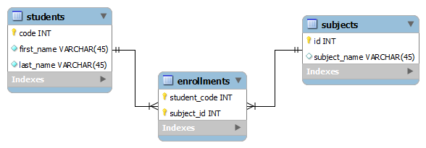
Visualizing the Relationships
The database includes a "many-to-many" relationship; each student can take many subjects, while each subject can of course chosen by many students.
To represent this, there is students table, subjects table, and enrollments table to show the combinations of the students enrolled in subjects and the subjects which taken by the students.

Slide 11

Table Students Schema
DROP TABLE IF EXISTS students;
CREATE TABLE IF NOT EXISTS students (
code INT NOT NULL,
first_name VARCHAR(45) NOT NULL, last_name VARCHAR(45) NOT NULL, PRIMARY KEY (code)
) ENGINE = InnoDB;

Slide 12

Table Students Data
INSERT INTO students
(code, first_name, last_name)
VALUES (20120, 'Abdul Rahman', 'Sherzad'),
(20121, | 'Cristina', 'Silva'),
(20122, | 'Bob', 'Logan'),
(20123, | 'Ana', 'Nava'),
(20124, | 'Sekila', 'Manzikalla');

Slide 13

Table Subjects Schema
DROP TABLE IF EXISTS subjects;
CREATE TABLE IF NOT EXISTS subjects (
id INT NOT NULL AUTO_INCREMENT,
subject_name VARCHAR(45) NULL,
PRIMARY KEY (id),
UNIQUE INDEX (subject_name)
) ENGINE = InnoDB;

Slide 14

Table Subjects Data
INSERT INTO subjects (id, subject_name)
VALUES (1, 'Web Development'), (2, 'Web Design'),
(3, 'Concept of Programming'),
(4, 'Fundamentals of Database Systems'), (5, 'Graphic Design');

Slide 15

Table Enrollments Schema
DROP TABLE IF EXISTS enrollments;
CREATE TABLE IF NOT EXISTS enrollments (
student_code INT NOT NULL,
subject_id INT NOT NULL,
PRIMARY KEY (student_code, subject_id),
FOREIGN KEY (student_code) REFERENCES students (code)
ON DELETE CASCADE
ON UPDATE CASCADE,
FOREIGN KEY (subject_id) REFERENCES subjects (id) ON DELETE CASCADE
ON UPDATE CASCADE
) ENGINE = InnoDB;

Slide 16

Table Enrollments Data
INSERT INTO enrollments (student_code, subject_id)
VALUES | (20120, | 1),
 | (20120, | 2),
 | (20121, | 2),
 | (20121, | 3),
 | (20122, | 3),
 | (20123, | 3),
 | (20122, | 4),
 | (20123, | 4);

Slide 17

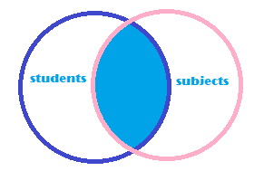
INNER JOIN (JOIN)
» The most frequently used clause is INNER JOIN or just JOIN.
» Fetching Matching Records From All the Tables
» Let's say we want to see which students taken which subjects.

Slide 18

INNER JOIN (JOIN)
SELECT code, first_name, last_name, subject_name
FROM students INNER JOIN enrollments
ON students.code = enrollments.student_code
INNER JOIN subjects
ON enrollments.subject_id = subjects.id;

Slide 19



Alternative I - INNER JOIN (JOIN)
SELECT code, first_name, last_name, subject_name
FROM students INNER JOIN enrollments
INNER JOIN subjects
ON students.code = enrollments.student_code
AND enrollments.subject_id = subjects.id;

Slide 20



Alternative II – Just JOIN
SELECT code, first_name, last_name, subject_name
FROM students JOIN enrollments
ON students.code = enrollments.student_code
JOIN subjects
ON enrollments.subject_id = subjects.id;

Slide 21


Alternative III – Where Clause
SELECT code, first_name, last_name, subject_name
FROM students, subjects, enrollments WHERE students.code = enrollments.student_code
AND enrollments.subject_id = subjects.id;

Slide 22

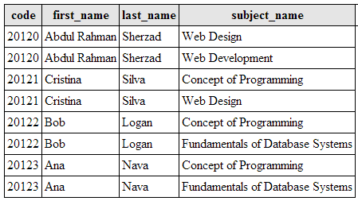
OUTPUT

Slide 23



Alternative IV - Alias
SELECT code AS 'Student Code',
first_name AS 'First Name',
last_name AS 'Last Name',
subject_name AS 'Subject'
FROM students AS stu INNER JOIN enrollments AS en
ON stu.code = en.student_code
INNER JOIN subjects AS sub
ON en.subject_id = sub.id;
26

Slide 24



Alternative V – Alias Refined
SELECT code 'Student Code',
first_name 'First Name',
last_name 'Last Name',
subject_name 'Subject'
FROM students stu INNER JOIN enrollments en
ON stu.code = en.student_code
INNER JOIN subjects sub
ON en.subject_id = sub.id;

Slide 25
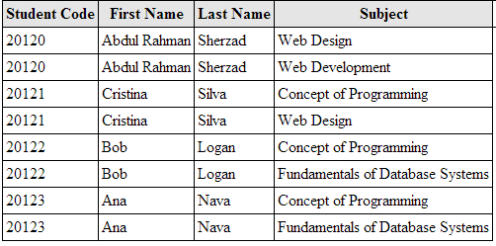
OUTPUT

Slide 26
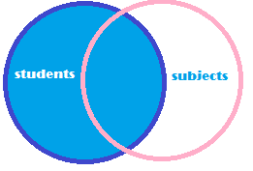
RIGHT JOIN (RIGHT OUTER JOIN)
» What if we require a list of all students and their subjects even if they are not enrolled on one?
» A RIGHT JOIN produces a set of records which matches every entry in the right table (students) regardless of any matching entry in the left table (subjects) and / or (enrollments).

Slide 27
RIGHT JOIN (RIGHT OTHER JOIN)
SELECT code, first_name, last_name, subject_name
FROM subjects INNER JOIN enrollments
ON subjects.id = enrollments.subject_id
RIGHT JOIN students
ON students.code = enrollments.student_code;

Slide 28
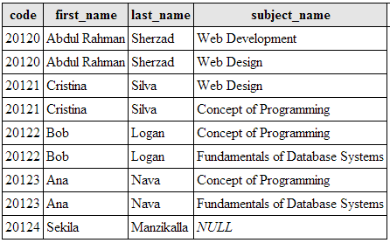

OUTPUT

Slide 29

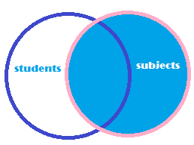
LEFT JOIN (LEFT OUTER JOIN)
» Let's change the scenario, perhaps we require a list of all subjects and students even if the subjects are not chosen by any students?
» A LEFT JOIN produces a set of records which matches every entry in the left table (subjects) regardless of any matching entry in the right table (students) and / or enrollments.

Slide 30
LEFT JOIN (LEFT OUTER JOIN)
SELECT subject_name, code, first_name, last_name
FROM subjects LEFT JOIN
( students INNER JOIN enrollments
ON students.code = enrollments.student_code )
ON subjects.id = enrollments.subject_id;

Slide 31


Alternative – RIGHT JOIN
SELECT subject_name, code, first_name, last_name
FROM students INNER JOIN enrollments
ON students.code = enrollments.student_code
RIGHT JOIN subjects
ON subjects.id = enrollments.subject_id

Slide 32
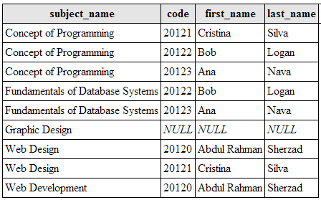

OUTPUT

Slide 33

LEFT JOIN vs. RIGHT JOIN
» LEFT (OUTER) JOIN and RIGHT (OUTER) JOIN
works exactly the same.
» ONLY the order of the tables are reversed!

Slide 34
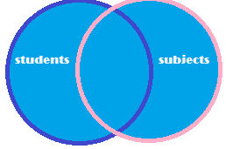
FULL JOIN (or FULL OUTER JOIN)
» The OUTER JOIN which returns all records in both tables regardless of any match. Where no match exists, the missing side will contain NULL.
» OUTER JOIN is less useful than INNER, LEFT or RIGHT joins and it's not implemented in MySQL.
» However, you can work around this restriction using the UNION of a LEFT and RIGHT JOIN.

Slide 35
FULL JOIN (or FULL OUTER JOIN)
SELECT code, first_name, last_name, subject_name
FROM subjects LEFT JOIN
( students INNER JOIN enrollments
ON students.code = enrollments.student_code )
ON subjects.id = enrollments.subject_id
UNION
SELECT code, first_name, last_name, subject_name
FROM subjects INNER JOIN enrollments
ON subjects.id = enrollments.subject_id
RIGHT JOIN students ON students.code = enrollments.student_code;

Slide 36
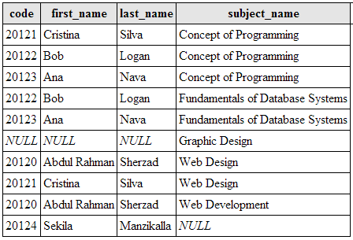
OUTPUT

Slide 37
Cross Join
» This is the default type of JOIN query when no condition is specified.
» The result is a so called "Cartesian Product" of the tables.
» It means that each row from the first table is matched with each row of the second table.
» Since each table had 5 rows, we ended up getting a result of 25 rows.

Slide 38
Cross Join
SELECT code, first_name, last_name, subject_name
FROM
students
CROSS JOIN
subjects;

Slide 39
Cross Join - Alternative
SELECT code, first_name, last_name, subject_name
FROM Students, subjects;

Slide 40
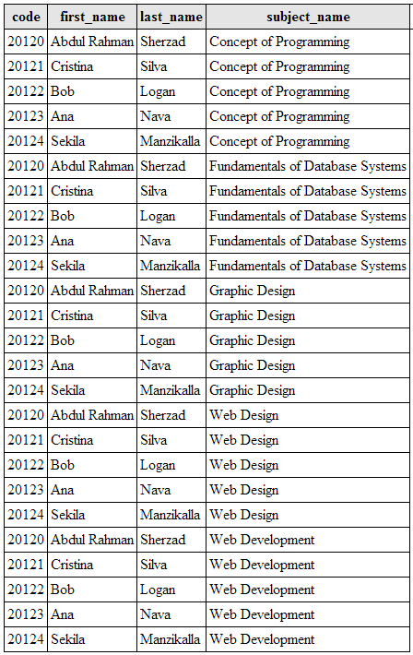
OUTPUT

Slide 41

SELF JOIN
» The SELF JOIN is used to join a table to itself as if the table were two tables; temporarily renaming at least one table in the SQL statement.
» You can view SELF JOIN as two identical tables. But in normalization you cannot create two copies of the table so you just simulate having two tables with SELF JOIN.

Slide 42
SELF JOIN
» Let's say you have a table named "users" with following structure:
UserID | UserName | ManagerID
1 | Abdul Rahman Sherzad | 0
2 | Ana Nava | 1
3 | Bob Logan | 2
4 | Cristina Silva | 3
User ID
User Name
˃
User's Manager's ID

Slide 43

Table Users Schema
CREATE TABLE IF NOT EXISTS users (
UserID int(11) NOT NULL AUTO_INCREMENT,
UserName varchar(50) NOT NULL, ManagerID int(11) NOT NULL, PRIMARY KEY (UserID)
) ENGINE=InnoDB;

Slide 44

Table Users Data
INSERT INTO users
(UserID, UserName, ManagerID) VALUES (1, 'Abdul Rahman Sherzad', 0),
(2, 'Ana Nava', 1),
(3, 'Bob Logan', 2),
(4, 'Cristina Silva', 3);

Slide 45



SLEF JOIN - Example
SELECT u.UserID, u.UserName AS 'User Name', m.UserName AS 'Manager Name'
FROM users u INNER JOIN users m
ON u.ManagerID = m.UserID;

Slide 46
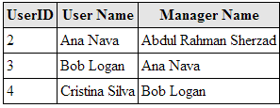
OUTPUT

Slide 47

SELF JOIN with LEFT JOIN
SELECT u.UserID, u.UserName AS 'User Name', m.UserName AS 'Manager Name'
FROM users u LEFT JOIN
ON u.ManagerID = m.UserID
ORDER BY u.UserID ASC;
users m

Slide 48
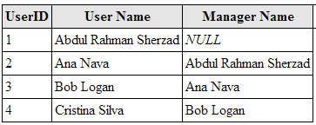
OUTPUT

Slide 49

Conclusion
» Thank you for reading this presentation. I hope you that it gives you a better understanding of JOINS and helps you write more efficient SQL queries as well as enjoyed it!
» Please leave your comments and questions, and have a great day ☺

